Slide 1
Preliminary Design Review
Smart Hub
Team 23
October 23, 2015
Notes:
‹#›
‹#›
‹#›

Slide 2
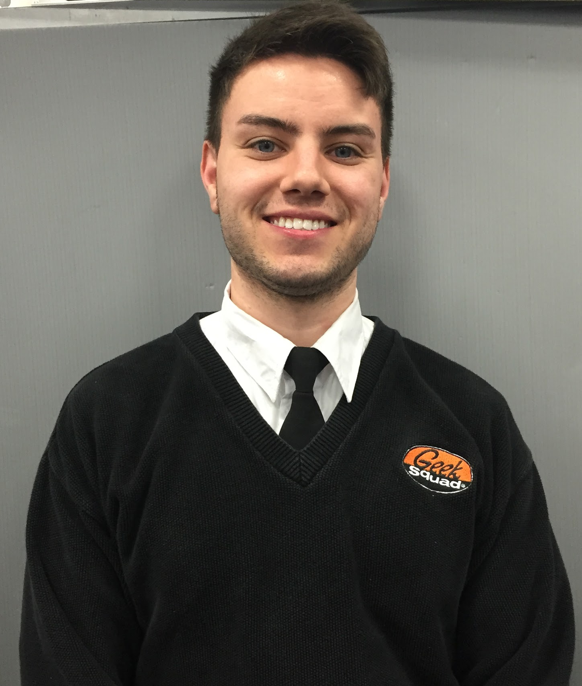
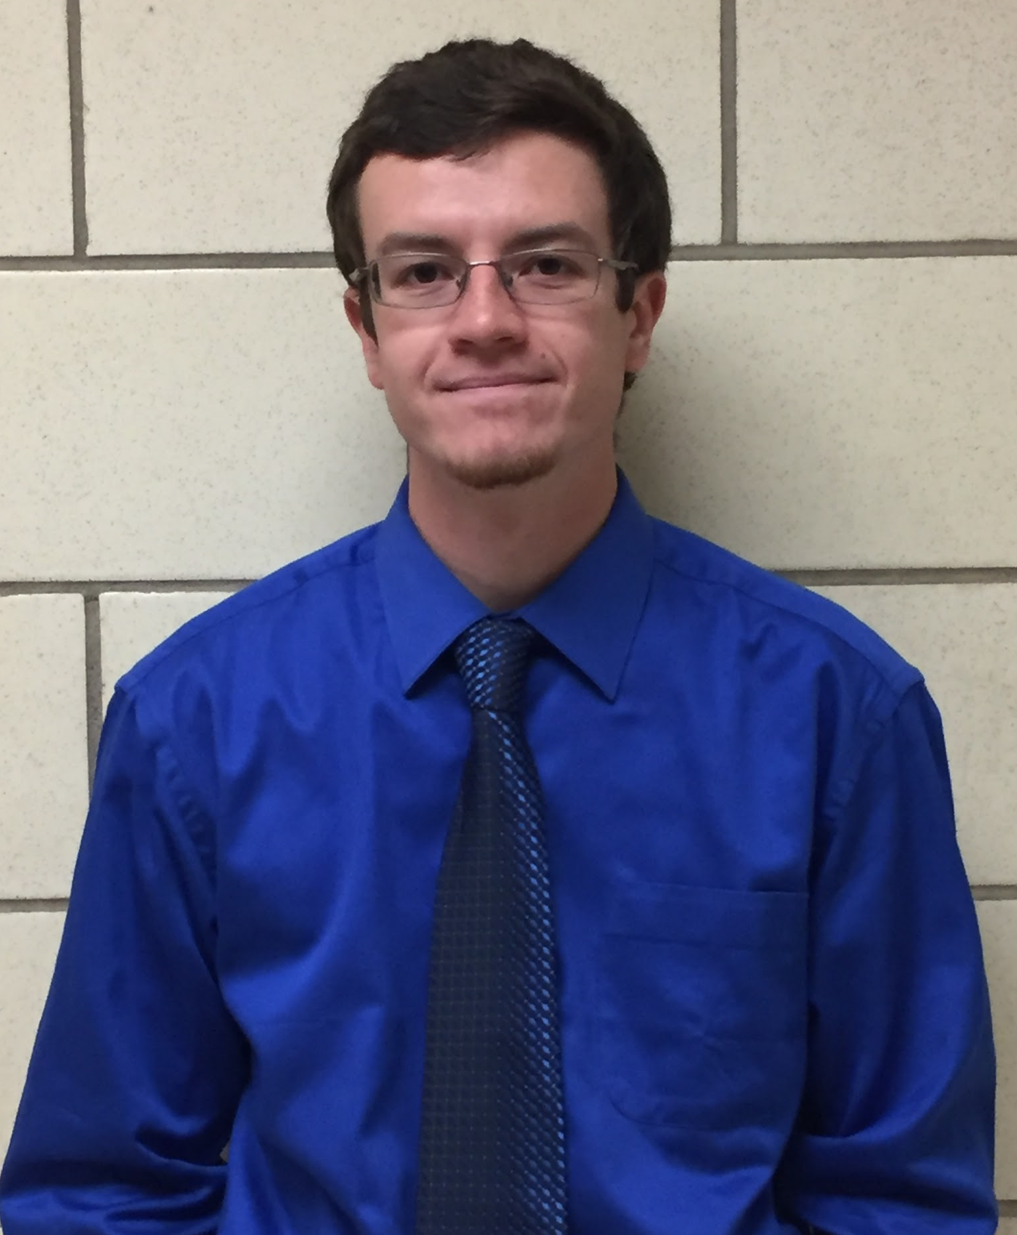
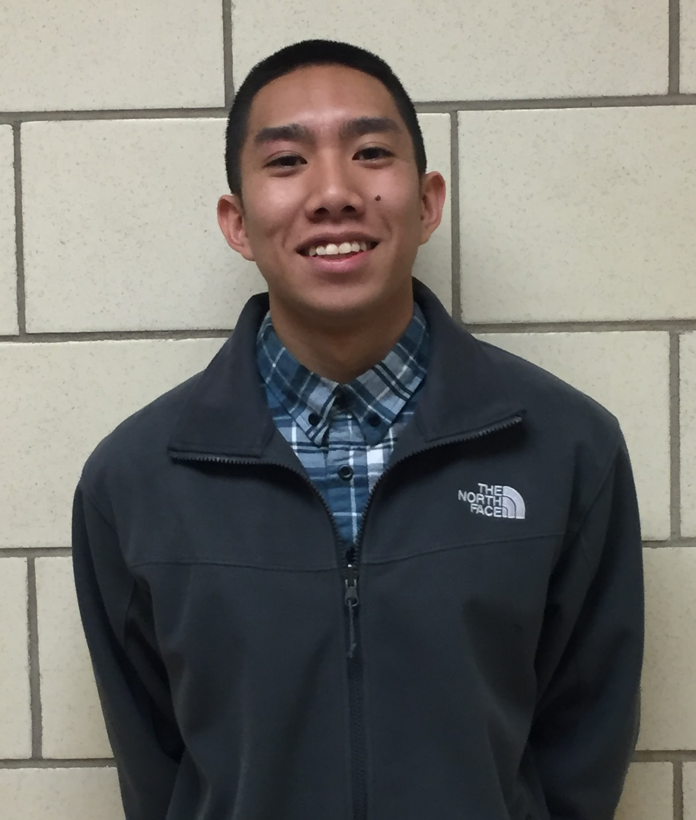




Patrick Lowry
EE ‘16
Team Manager
Chris Mitchell
EE ‘16
Sidney Saycocie
EE ‘16
Aman Sardana
EE ‘16

Slide 3

Project Inception
The past decade has seen a massive increase in home appliance complexity. This implies:
- Increased global power consumption, greater energy costs.
- Confusion amongst new users who may be unfamiliar with the operation of a device
- Isolation of potential customers with some sort of disability

Slide 4
Motivation
Appliance operation can be easily optimized to suit a resident’s needs and lifestyle.
- More responsive and dynamic based on external environment
- One that doesn’t rely on a complex control system-- multiple remotes
- Should be easy to set up
- Should improve quality of life

Slide 5
Our solution: Smart Hub
A device that is always listening, always working with your appliances to provide a better living experience. It collects data from:
The user: Voice and web controlled commands to operate your appliances
- The internet: Tracks weather forecasts, sunrise and sunset times, modulates light sources and temperature control

Slide 6
Requirements (Hub)
Wireless Communication
- Internet: Wifi (using wireless router and ethernet)
- Must be able to control a retail smart device (Belkin WeMo)
- RF Peripheral Control: 315MHz and 433MHz
- Must be able to control AC window unit with IR
- Minimum range of RF: 20m (including through cinderblock)
Voice Control
- Jasper (open source voice control platform)
- Built-In Microphone and Speakers
- Confidence of Jasper (when to ask for confirmation)

Slide 7

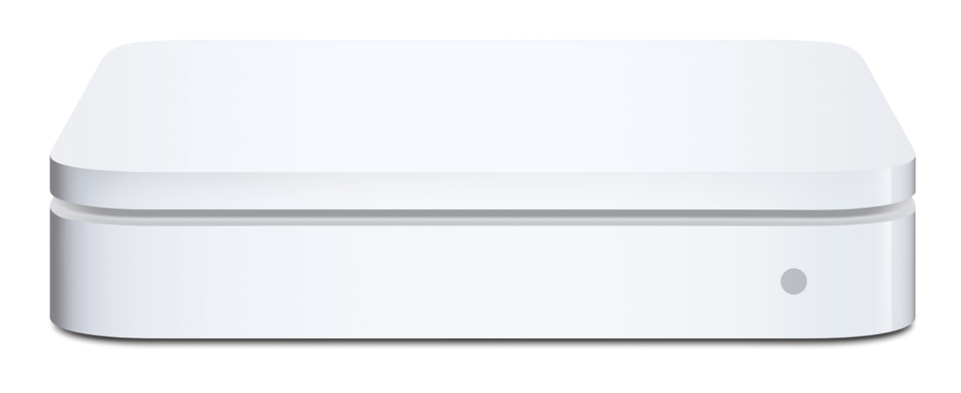
Requirements (Hub cont.)
Basic Operation and Design
- Controlled by Raspberry Pi 2
- Operates at 12VDC (RP2 can supply 5V and 3.3V)
- Uses Raspbian OS with autorun Python scripts
- Provides web server for remote control of devices
- Sleek, unobtrusive design

Slide 8
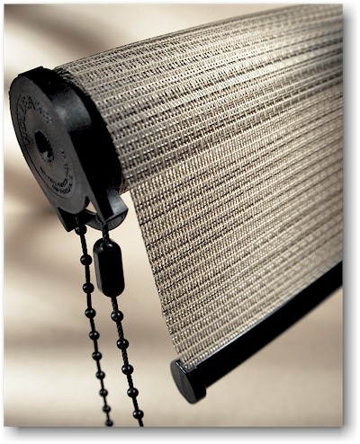
Requirements (Blinds)
Communication
- 315MHz RF Receiving and 433MHz Transmitting Antennas
Basic Operation and Design
- Open and close commands (8-bit RF signal)
- <5sec
- Must use ATtiny85 microcontroller (8KB)
- Must use Arduino IDE and Manchester code for RF
- Must operate at 12VDC for motor and driver, 3-5V for ATtiny85 and RF
- Motor must have enough torque for roller blinds (~26-30Ncm)

Slide 9
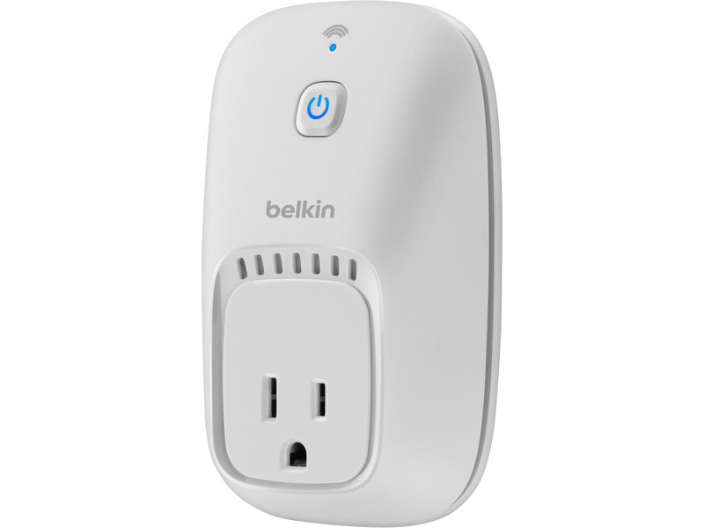
Requirements (WeMo)
Response Time
- <1sec from RP2 command
Communication
- WiFi (using MAC address of device)
Basic Operation
- On and off commands
- 110VAC (15A/1800W max)
- Controllable from web server and Jasper

Slide 10
Requirements (Temp. Probe)
Report Time
- User determined (via web server or Jasper)
- Or, 1 sample recorded and sent per minute (automatic setting)
Communication
- 433MHz RF transmitting antenna
- Send temperature and humidity (16-bit)
Basic Operation and Design
- Monitors indoor temperature and humidity for AC control
- Must use ATtiny85 microcontroller and DHT11 temperature/humidity sensor

Slide 11
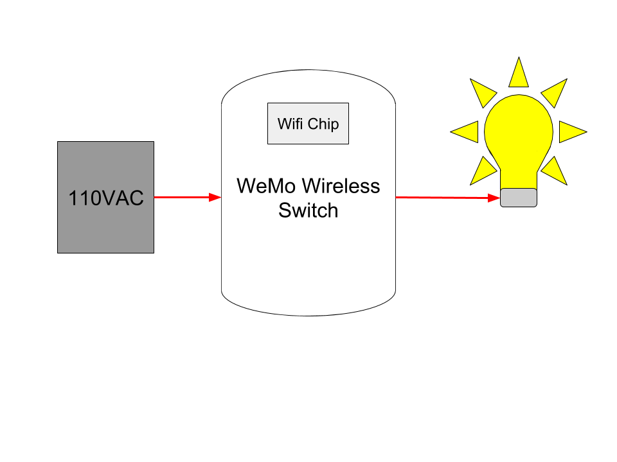
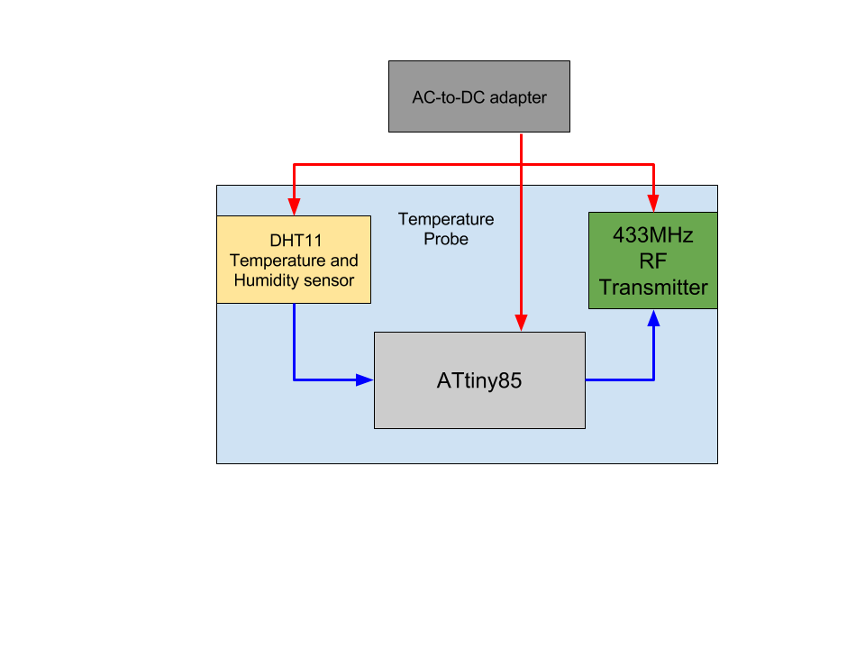
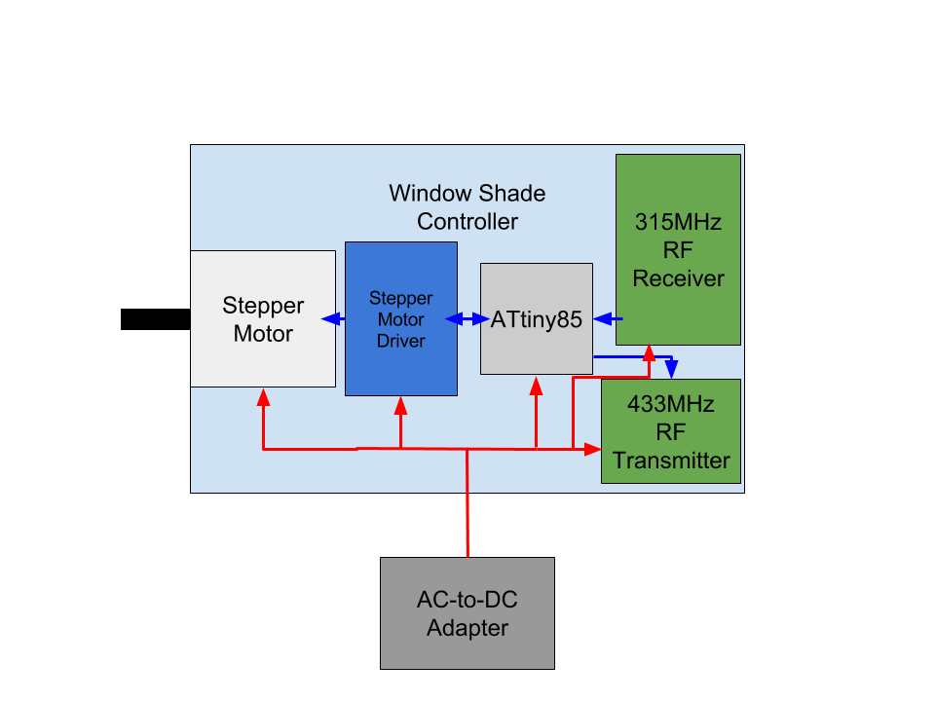
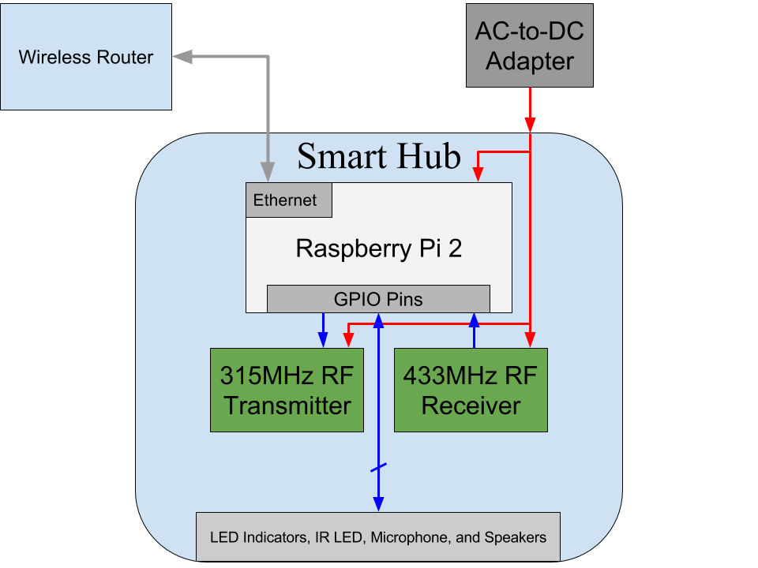
Block Diagram (System)
Legend
Power
Information
Ethernet
WiFi
315MHz
433MHz
IR
Window AC Unit

Slide 12
Block Diagram (Hub)
Legend
Power
Information
Ethernet

Slide 13
Block Diagram (cont.)
Legend
Power
Information

Slide 14
Block Diagram (cont.)
Legend
Power

Slide 15
Block Diagram (cont.)
Legend
Power
Information

Slide 16
Software
Smart Hub
Command Hierarchy
ATtiny85
Python Scripts (autorun w/ crontab)
Manchester Code
Web Server
Jasper
Apache
Arduino IDE
Automatic Settings
Raspbian OS

Slide 17
Societal Impact and Significance
Smart Hub will greatly account for people with disabilities
Jasper will enable seamless control of devices for people with physical disabilities
Password protected web server will allow authorized users to monitor status of home
It will make lighting and AC systems more efficient -- Energy saving
Enables users to turn off their high power consumption devices from anywhere
Can adjust settings automatically, even if user is away
Extremely user-friendly
Easy setup process, simple web server UI, basic voice commands

Slide 18
Alternatives
- Exclusively wifi (more expensive)
- Bluetooth (limited range)
-Peripherals powered by batteries
- Pre-designed and pre-coded RF chips
- Buying more retail devices (Philips Hue, Nest)
- Android app rather than basic web server
- Wearable device (e.g. Fitbit, smartwatch)

Slide 19
Additional Ideas
Peripherals
Refined light controls:
- RGB LED’s, dimmable, change color temperature
Motion sensors:
- Turn lights on/off when leaving or entering room (or house)
Code
- Window shades can be adjusted to varying levels
- Turn off AC after leaving house, turn on automatically before returning

Slide 20
MDR Deliverables
A fully assembled, enclosed hub capable of:
Interacting with a Wemo light bulb
Performing and responding to basic voice commands using Jasper
Reporting indoor temperature from probe
Able to remotely manage window shade controller

Slide 21

Questions

